Slide 1
Solutions to Road Congestion
by Reinforced Learning
Sang-Min Lee, Min-Yeop Choi, Seung-Hyun Lee, Chang-Jun Son
Guidance teacher Joo-Yeon Seo
Kyeongbuk Science High School

Slide 2
Table of Contents
Abstract
Background of research
Theoretical background
A research method
Research Results
Consideration and Conclusion
Reference Literature

Slide 3
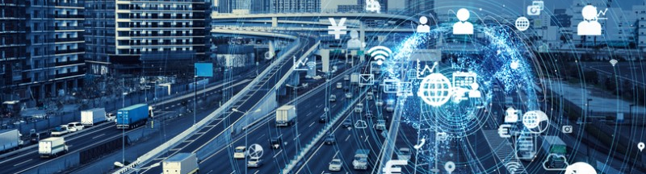
Abstract
As the population grows, traffic congestion is causing many problems.
To solve this traffic congestion, a new paradigm of artificial intelligence research is needed.
Therefore, we want to solve traffic congestion by controlling traffic lights through deep learning and reinforcement learning.

Slide 4
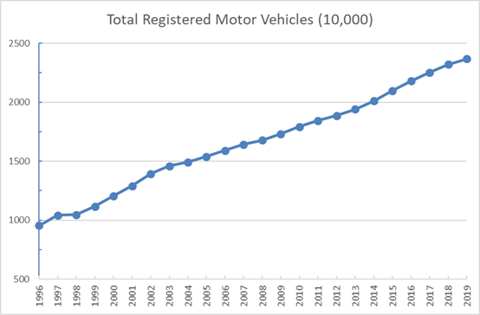
Background of research (1)
The number of cars in Korea :
1997 10 million →
2019 23 million
The number of cars has more than doubled

Slide 5
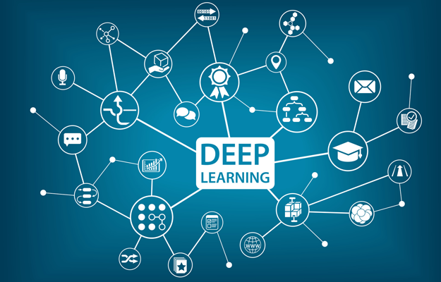
Background of research (2)
As a result, the transportation is a field that requires analysis using large-scale data, and deep learning research has been conducted in various fields recently.

Slide 6
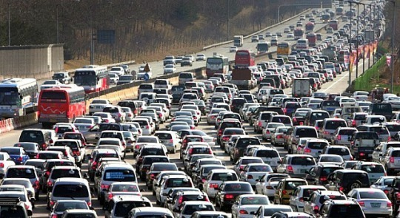
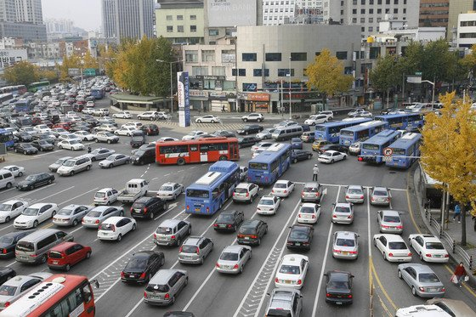
Theoretical background (1)

Slide 7

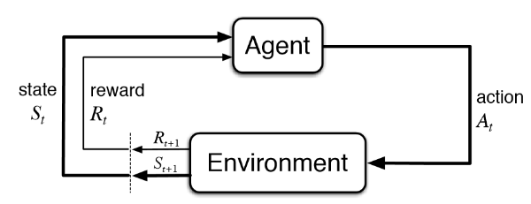
Theoretical background (2)

Slide 8
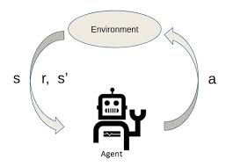



Theoretical background (3)

Slide 9
A research method
Understanding of Reinforcement Learning
Build Development Environment
Build Environment
Build Agent
Coding
Run the program and Learning
Check and evaluate learning outcomes

Slide 10
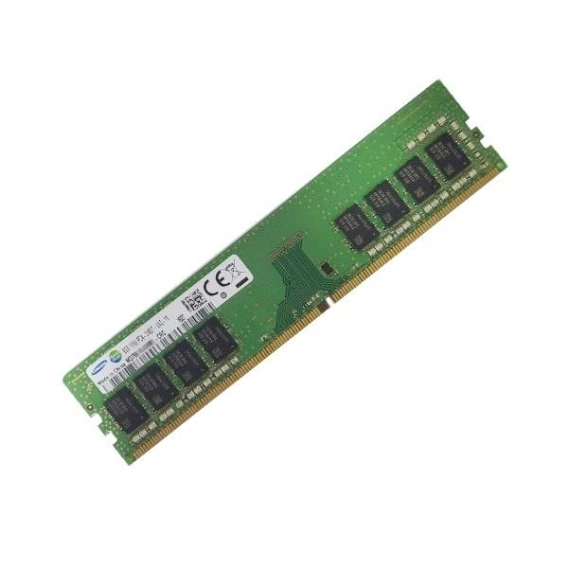


2. Development Environment
I7-9700
RAM 16GB
Windows 10

Slide 11
3. Build Environment
car_data -
Road Length : 2000
Number of cars : 100
tlight_data - Red light → 0, Green light → 1
the speed of a car - 4 Levels
v=0(Stop), v=1(Congestion), v=2(Delay), v=3(Smooth)

Slide 12
4. Build Agent
Check the status of the traffic lights
→ Determining action based on the value of ε
→ Decide on a reward
→ Q-learning update
→ Check Time
→ Repetition

Slide 13
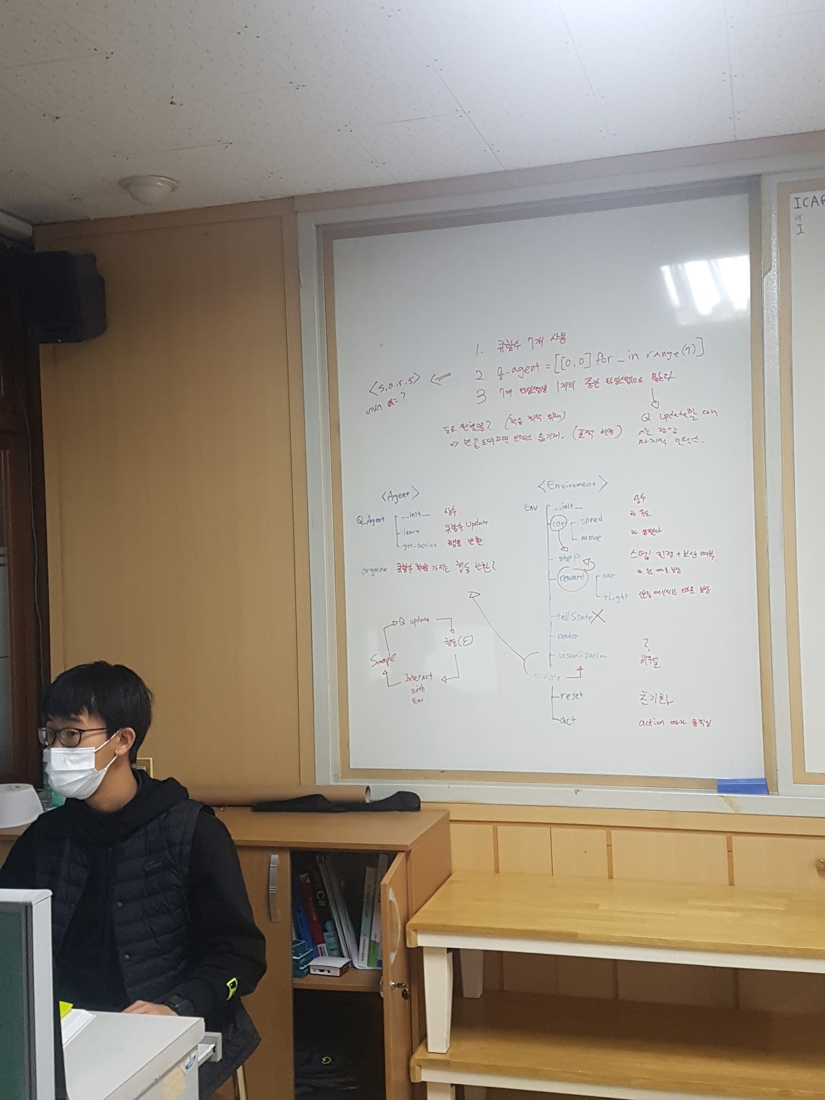
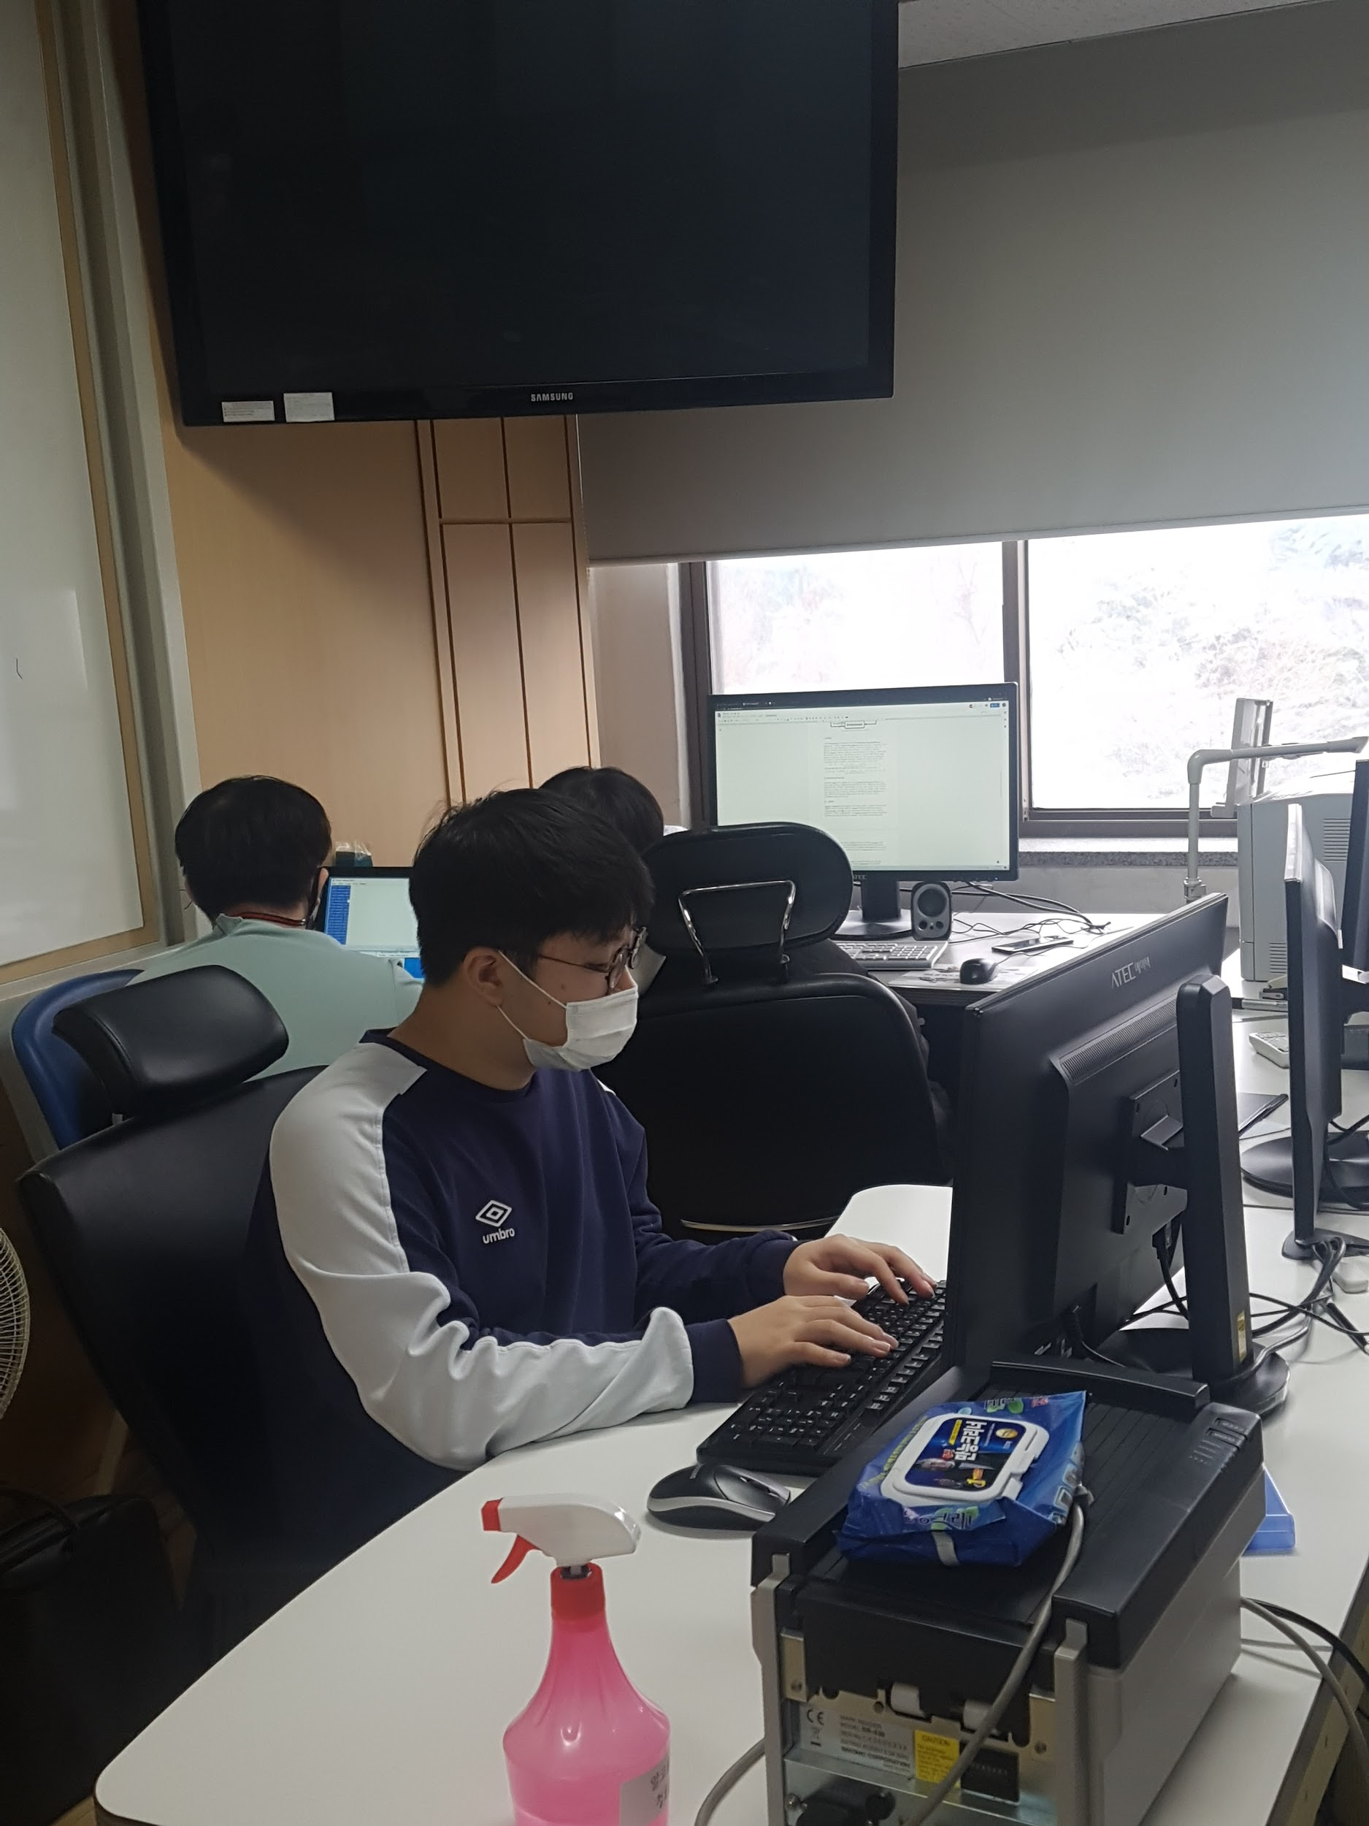
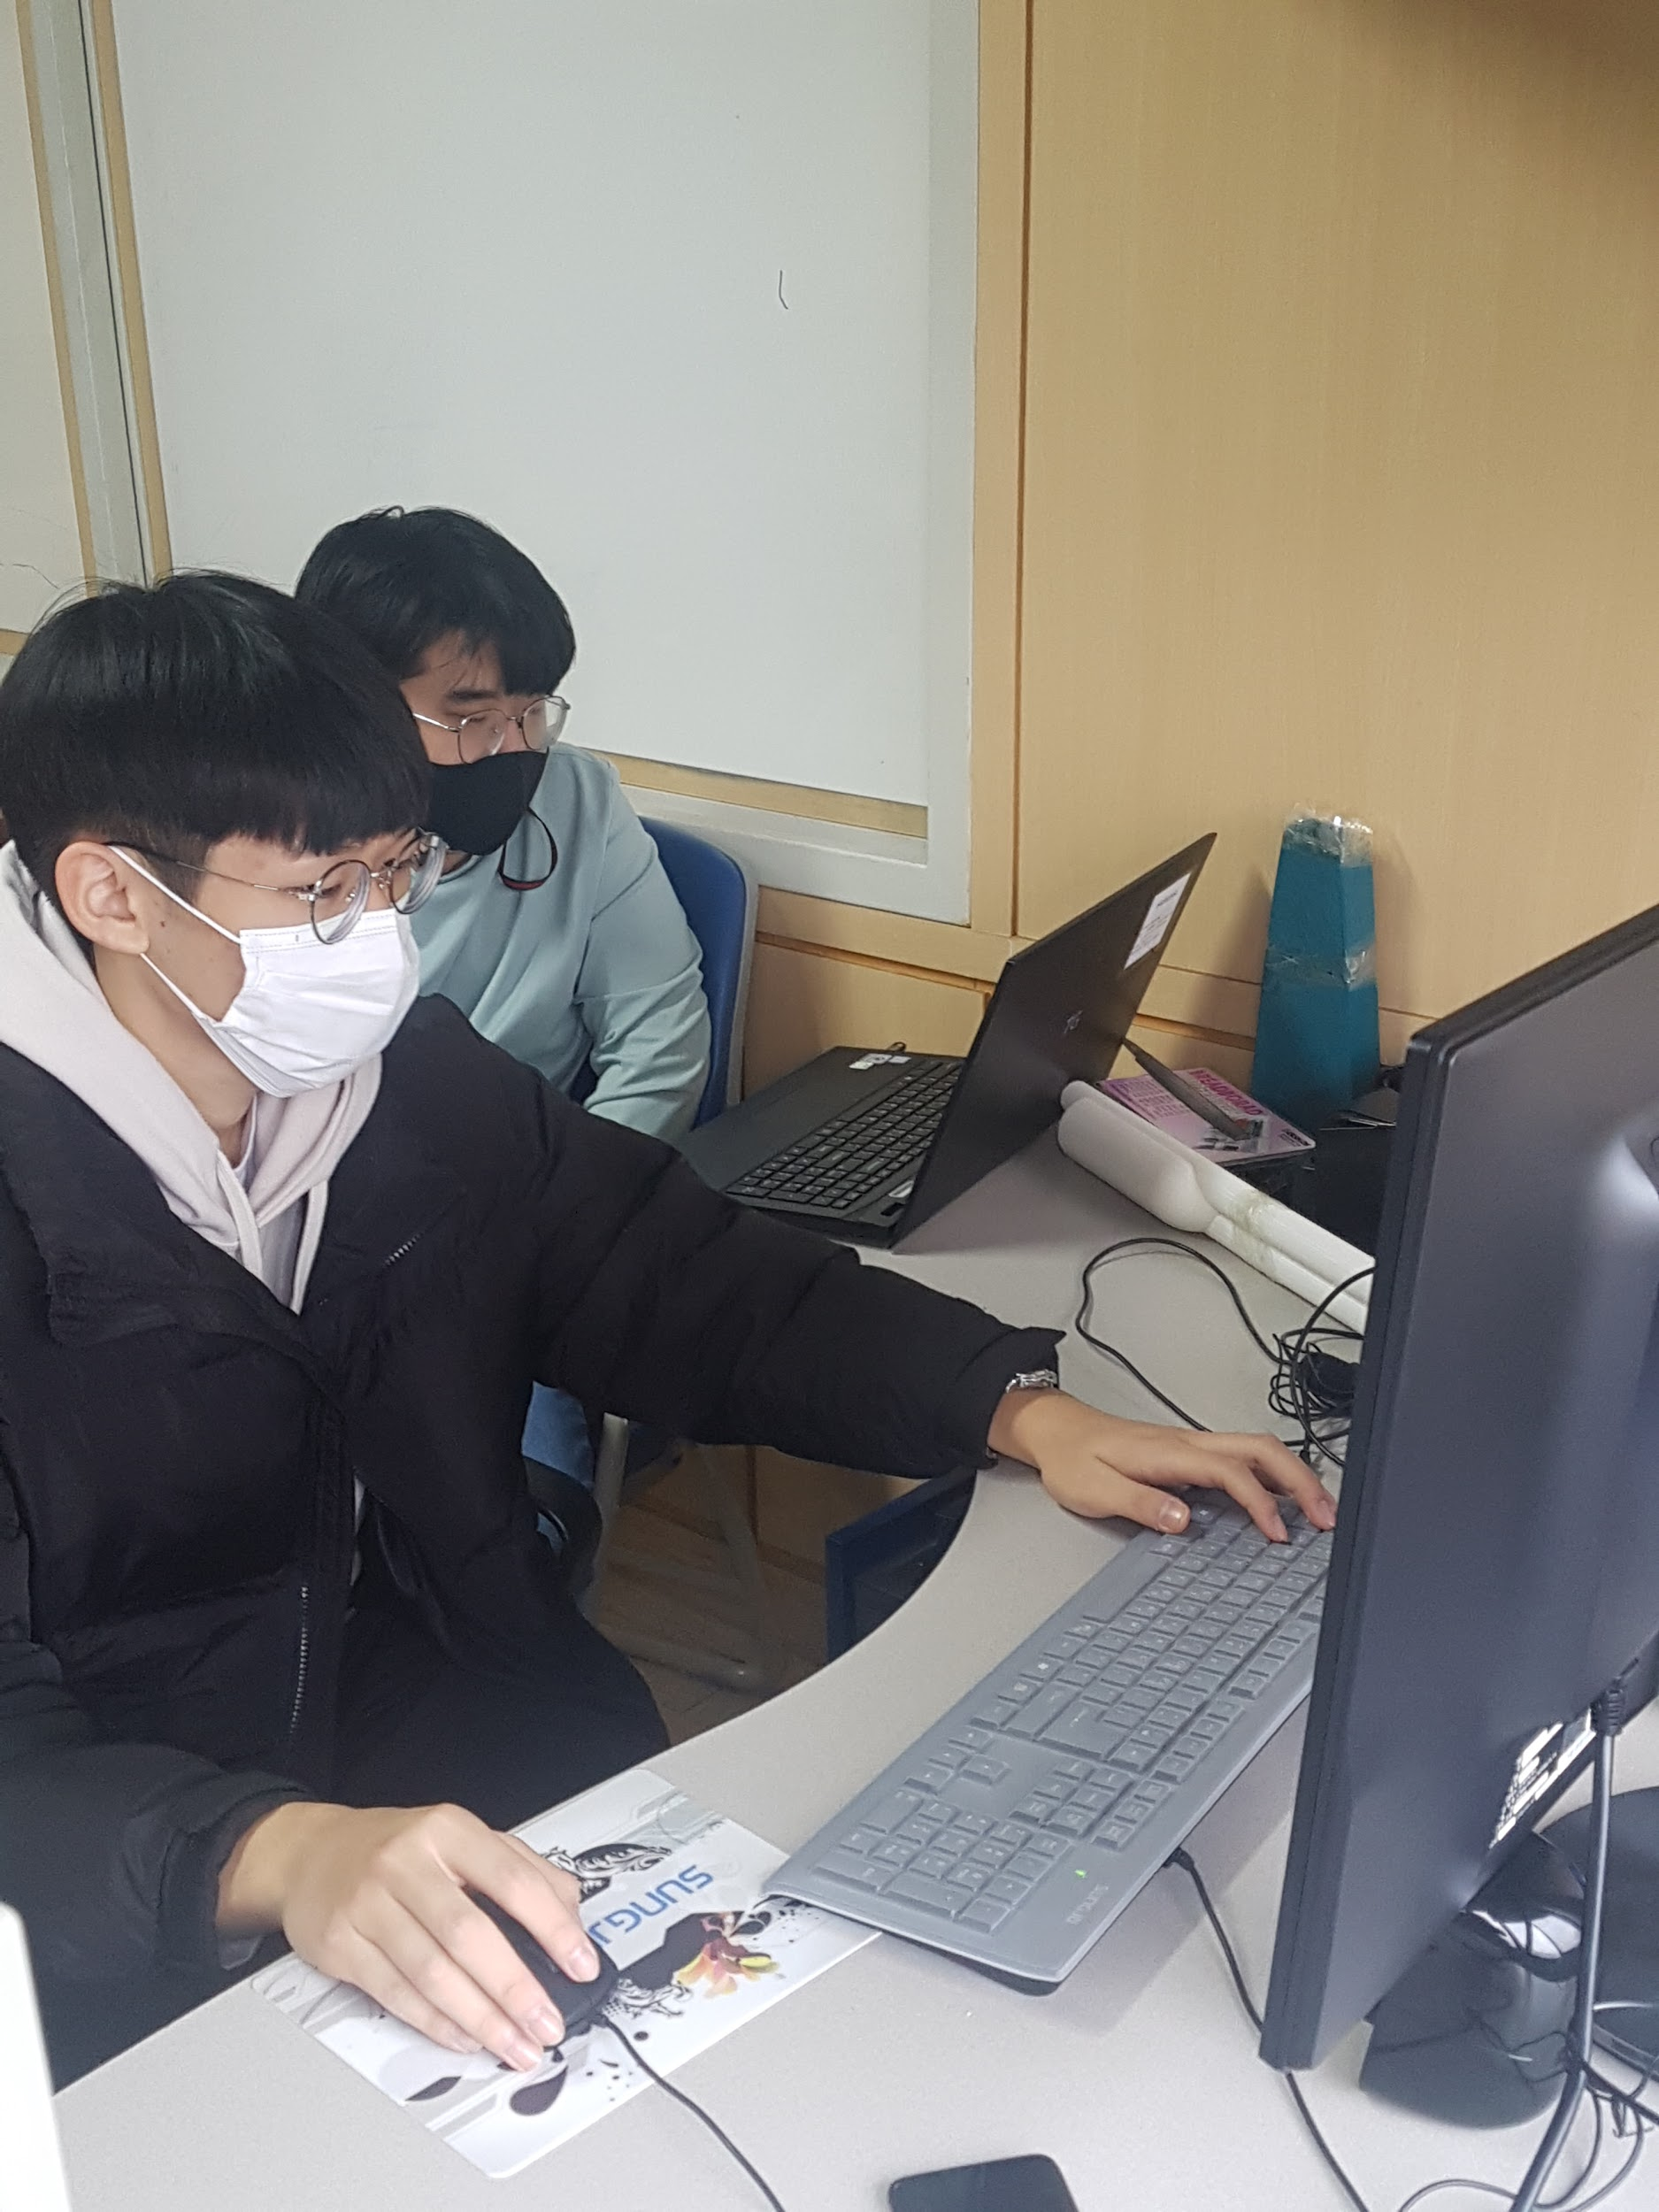
5. Coding
[Coding]

Slide 14
A research method
Run the program and Learning
Check and evaluate learning results

Slide 15
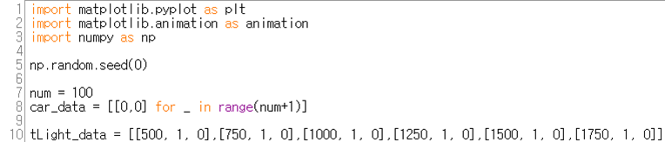
Environment Module - Settings
call libraries
declare global variables

Slide 16
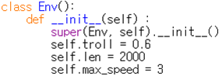
Environment Module - Settings for Env class
set variables inside Env class

Slide 17
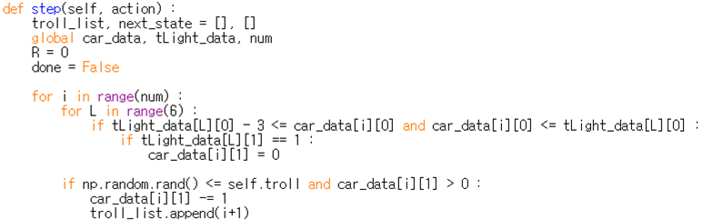
Environment Module - Env.step (1)
call global variables
stop cars if red light is on where car is at
randomly decrease cars’ speed according to value of self.troll

Slide 18
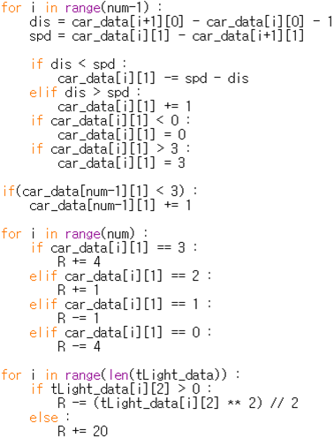
Environment Module - Env.step (2)
controll speed of cars according to the distance between cars and relative speed
give reward according to the speed of cars and state of traffic lights

Slide 19
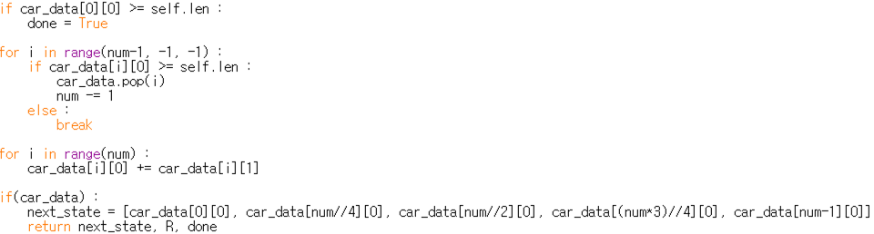
Environment Module - Env.step (3)
remove cars when they go over the given length of road
move cars by their speed

Slide 20
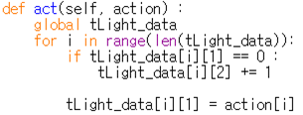
Environment Module - Env.act
change state of traffic lights according to the actions

Slide 21
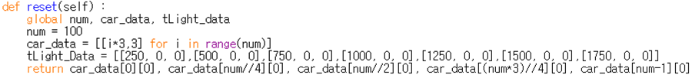
Environment Module - Env.reset
reseting the environment
used when a new episode starts

Slide 22
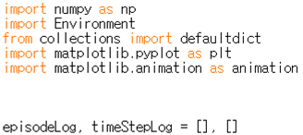
Agent Module - Settings
call libraries

Slide 23
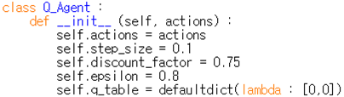
Agent Module - Settings for Q_Agent class
set variables that will be used in the Q_Agent class

Slide 24
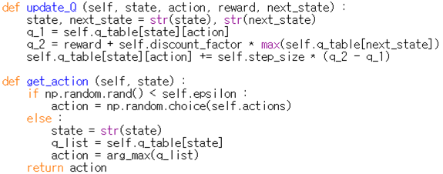
Agent Module - functions of Q_Agent (1)
the Q_Agent class helps the Agent to calculate the Q functions
update_Q function updates the Q function, using the sample <s, a, r, s’> (state, action, reward, next state)

Slide 25
Agent Module - functions of Q_Agent (2)
choose the action according to the Q table and epsilon-greedy policy

Slide 26
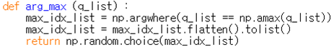
Agent Module - arg_max function
returns the action that has the largest Q function

Slide 27
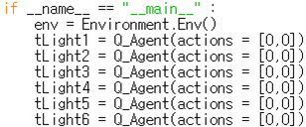
Agent Module - Settings for __main__
call Enviroment and
declare Q functions for each traffic lights

Slide 28
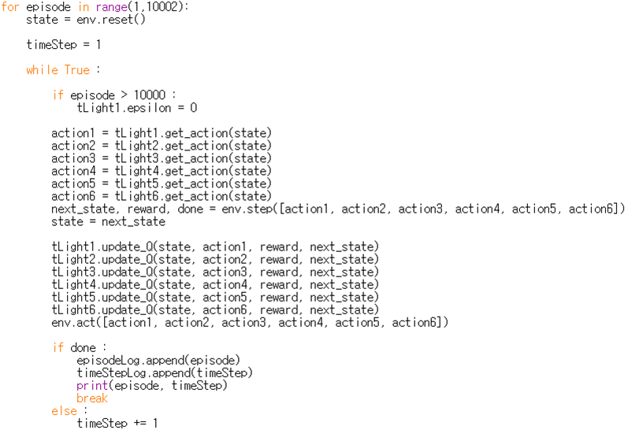
Agent Module - Learning Process
get action, according to state
progress the timestep and get the samples needed for updating the Q function
update the Q function with the given samples

Slide 29
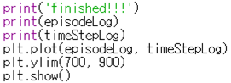
Agent Module - Show Learning Graph
show graph of learning and travelling using matplotlib

Slide 30
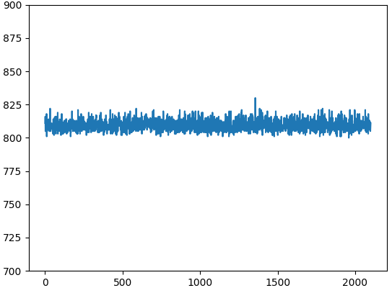
Results in Learning (2100 Episodes)

Slide 31
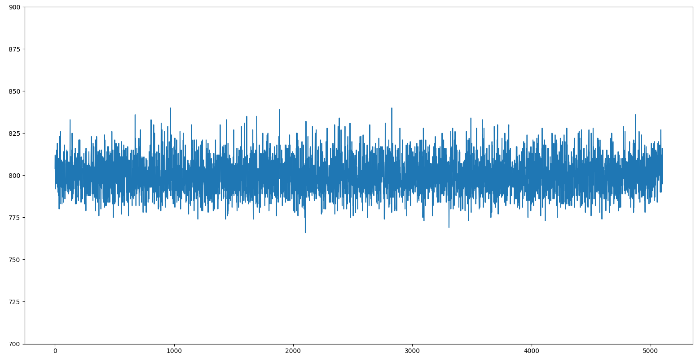
Results in Learning (5100 Episodes)

Slide 32
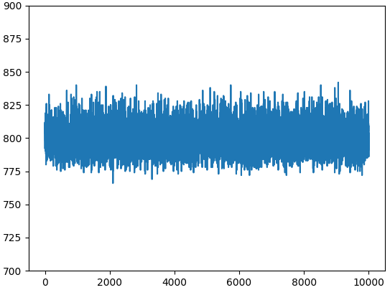
Results in Learning (10001 Episodes)

Slide 33
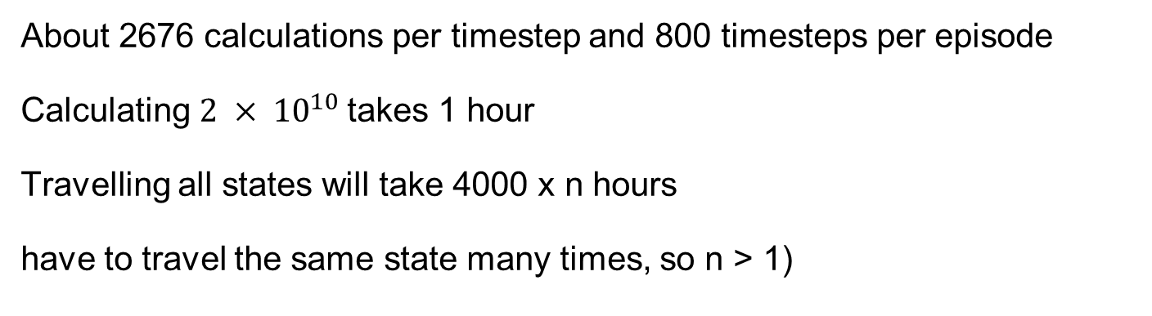
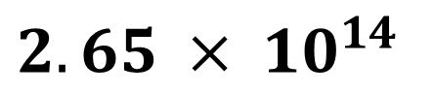
Considerations (1)
$$2.65 × {10}^{14}$$
The Possible number of States
About 2676 calculations per timestep and 800 timesteps per episode
Calculating $2 × {10}^{10}$takes 1 hour
Travelling all states will take 4000 x n hours
have to travel the same state many times, so n > 1)

Slide 34
Considerations (2)
Times that the Agent Travelled = 10000
which means that it could only explore
maximum 0.00000003% of the possible states
Machine Learning’s Limit is Revealed, so
We need Deep Learning!!!

Slide 35
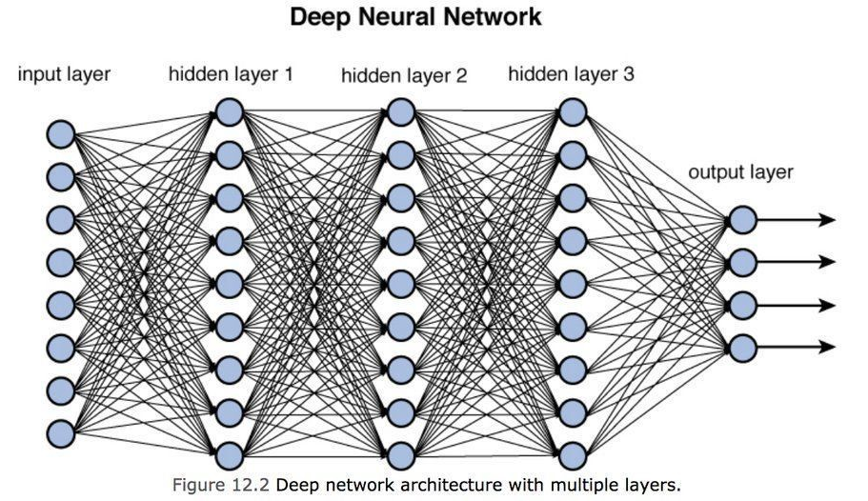
Why Deep Learning?
Q_Learning is better to use in a problem with a smaller state
To resolve the curse of dimensions, we need to use an
approximate function
DNN = kind of approximate function
Why use DNN?
-uses many hidden layers,
easy to calculate in complex situations
-better to use GPU

Slide 36
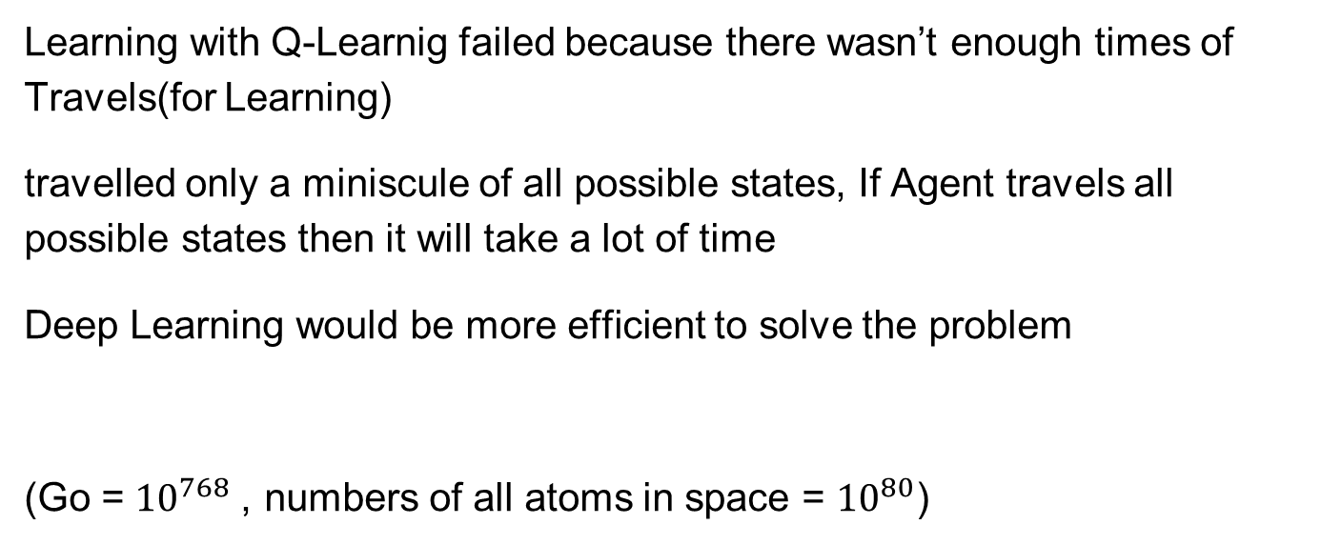
Conclusion
Learning with Q-Learnig failed because there wasn’t enough times of Travels(for Learning)
travelled only a miniscule of all possible states, If Agent travels all possible states then it will take a lot of time
Deep Learning would be more efficient to solve the problem
(Go = ${10}^{768}$, numbers of all atoms in space = ${10}^{80}$)

Slide 37
Reference Literature
[1] 파이썬과 케라스로 배우는 강화학습 (이웅원 외 3명 저, 위키북스)
[2] Do it! 점프 투 파이썬 (박응용 저, 이지스퍼블리싱)
[3] 알고리즘으로 배우는 인공지능, 머신러닝, 딥러닝 입문 (김의중 저, 위키북스)
[4] 파이썬 머신러닝 완벽 가이드(권철민 저, 위키북스)
[5] numpy official site
[6] matplotlib official site

Slide 38
Reference
도로 정체 사진 - 해럴드 경제 http://heraldk.com/2016/01/02/%EC%97%B0%ED%9C%B4-%EB%A7%88%EC%A7%80%EB%A7%89%EB%82%A0%EA%B3%A0%EC%86%8D%EB%8F%84%EB%A1%9C-%EC%A0%95%EC%B2%B4-%EC%98%A4%ED%9B%84-4%EC%8B%9C-%EC%A0%84%ED%9B%84-%EC%B5%9C/
강화 학습 사진 - IT위키
http://itwiki.kr/w/%EA%B0%95%ED%99%94_%ED%95%99%EC%8A%B5
딥러닝 사진 - tistory 블로그
https://dororongju.tistory.com/145
cpu 사진 - 아마존
https://www.amazon.com/Intel-i7-9700-Desktop-Processor-LGA1151/dp/B07S6CRLVD
메모리 사진 - 11번가
http://www.11st.co.kr/products/2029297650?utm_medium=%EA%B2%80%EC%83%89&gclid=Cj0KCQiAoab_BRCxARIsANMx4S4iWrw6dDjJXSv3lTVk6YTZZXUPgZ5itMUGsouiBEIogI9sc8a-nBgaAtCGEALw_wcB&utm_source=%EA%B5%AC%EA%B8%80_PC_S_%EC%87%BC%ED%95%91&utm_campaign=%EA%B5%AC%EA%B8%80%EC%87%BC%ED%95%91PC+%EC%B6%94%EA%B0%80%EC%9E%91%EC%97%85&utm_term=
윈도우 사진 - simpleworld
https://simpleworld.kr/entry/%EC%9C%88%EB%8F%84%EC%9A%B010-%EB%8B%A8%EC%B6%95%ED%82%A4-%EB%AA%A8%EC%9D%8C
바둑의 경우의 수 - LG 사이언스랜드
http://lg-sl.net/product/scilab/sciencestorylist/ALMA/readSciencestoryList.mvc?sciencestoryListId=ALMA2020050003&subjectId=MAT

